Slide 1





Advanced Loops
While, Do…While
Advanced Loops
SoftUni
Trainers Team
Software University
https://softuni.org

Slide 2

Table of Contents
More complex constructs for loops:
Loop with a step
Loop with decreasing step
while loop
do-while loop
Infinite loop and operator break
Complex problems with nested loops
Creating a Web game with ASP.NET MVC

Slide 3


Loops With a Step
Working with more complex for-loops

Slide 4
Numbers from 1 to N with step 3
Print the numbers from 1 to n with step 3
Given n = 100: 1, 4, 7, 10, …, 94, 97, 100
int n = int.Parse(Console.ReadLine());
for (var i = 1; i <= n; i+=3)
{
Console.WriteLine(i);
}
Define a step
Testing the solution: https://judge.softuni.bg/Contests/Practice/Index/156#0

Slide 5

Numbers from N to 1 in reverse order
Print the numbers from n to 1 in reverse order (step -1)
Given n = 100: 100, 99, 98, …, 3, 2, 1
int n = int.Parse(Console.ReadLine());
for (var i = n; i >= 1; i-=1)
{
Console.WriteLine(i);
}
Negative step: -1
Reverse condition: i >= 1
Testing the solution: https://judge.softuni.bg/Contests/Practice/Index/156#1

Slide 6
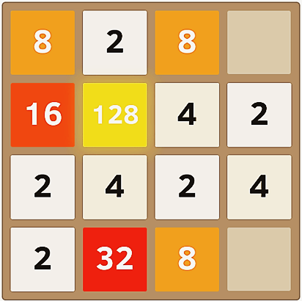
Numbers from 1 to 2^{n} with for-loop
Print the numbers from 1 to 2^{n}
При n = 10: 1, 2, 4, 8, 16, 32, 64, 128, 256, 512, 1024
int num = 1;
for (var i = 0; i <= n; i++)
{
Console.WriteLine(num);
num = num * 2;
}
Testing the solution: https://judge.softuni.bg/Contests/Practice/Index/156#2

Slide 7
Even powers of 2
Print the even powers of 2 until 2^{n}: 2⁰, 2², 2⁴, 2⁸, …, 2^{n}
Given n = 10: 1, 4, 16, 64, 256, 1024
int num = 1;
for (var i = 0; i <= n; i+=2)
{
Console.WriteLine(num);
num = num * 2 * 2;
}
Ползваме стъпка 2
Testing the solution: https://judge.softuni.bg/Contests/Practice/Index/156#3

Slide 8

While loop
невярно
условие
вярно
while
команди
Repetition while a condition is met

Slide 9
Number sequence 2k+1
Print all numbers ≤ n from the sequence: 1, 3, 7, 15, 31, …
Every next number = previous number * 2 + 1
int num = 1;
while (num <= n)
{
Console.WriteLine(num);
num = 2 * num + 1;
}
Повтаряй докато е в сила условието num ≤ n
1, 3, 7, 15, 31, 63, …
Testing the solution: https://judge.softuni.bg/Contests/Practice/Index/156#4

Slide 10

Number in range [1…100]
Input a number in range [1…100]
If the number is invalid, input again
var num = int.Parse(Console.ReadLine());
while (num < 1 || num > 100)
{
Console.WriteLine("Invalid number!");
num = int.Parse(Console.ReadLine());
}
Console.WriteLine("The number is: {0}", num);
Testing the solution: https://judge.softuni.bg/Contests/Practice/Index/156#5

Slide 11
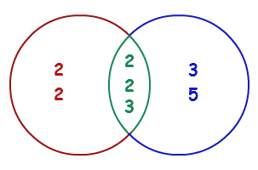
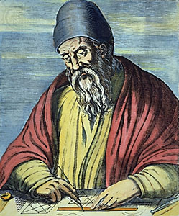
Greatest common denom. (GCD)
Euclid’s algorithm

Slide 12
Greatest Common Denominator (GCD)
Greatest Common Denominator of two natural numbers a and b is the greatest number, which divides both a and b without remainder
GCD(24, 16) = 8
GCD(67, 18) = 1
Euclid’s algorithm for finding the GCD:
Until we reach remainder 0
Divide the greater number by the smaller one
Take the remainder from division
GCD(12, 24) = 12
GCD(15, 9) = 3
GCD(10, 10) = 10
GCD(100, 88) = 4
while b ≠ 0
var oldB = b;
b = a % b;
a = oldB;
print а;

Slide 13
Euclid’s algorithm for finding GCD
Input two integers a and b and find GCD(a, b)
var a = int.Parse(Console.ReadLine());
var b = int.Parse(Console.ReadLine());
while (b != 0)
{
var oldB = b;
b = a % b;
a = oldB;
}
Console.WriteLine("GCD = {0}", a);
Testing the solution: https://judge.softuni.bg/Contests/Practice/Index/156#6

Slide 14
Do…While Loop
команди
do-while
вярно
невярно
условие
Repetition until the condition is met

Slide 15
Calculate Factorial
Given natural number n, find n! = 1 * 2 * 3 * … * n
Example: 5! = 1 * 2 * 3 * 4 * 5 = 120
var n = int.Parse(Console.ReadLine());
var fact = 1;
do
{
fact = fact * n;
n--;
} while (n > 1);
Console.WriteLine(fact);
n!
Testing the solution: https://judge.softuni.bg/Contests/Practice/Index/156#7

Slide 16
Sum digits of number
Sum digits of whole number n
Given n = 5634: 5 + 6 + 3 + 4 = 18
var n = int.Parse(Console.ReadLine());
var sum = 0;
do
{
sum = sum + (n % 10);
n = n / 10;
} while (n > 0);
Console.WriteLine("Sum of digits: {0}", sum);
n % 10 returns the last digit of n
n / 10 removes the last digit from n
Testing the solution: https://judge.softuni.bg/Contests/Practice/Index/156#8

Slide 17


Infinite loops and break operator
break
break
безкраен цикъл

Slide 18


Infinite Loop
An infinite loop repeats something infinitely:
while(true)
{
Console.WriteLine("Infinite loop");
}
for (;;)
{
Console.WriteLine("Infinite loop");
}

Slide 19
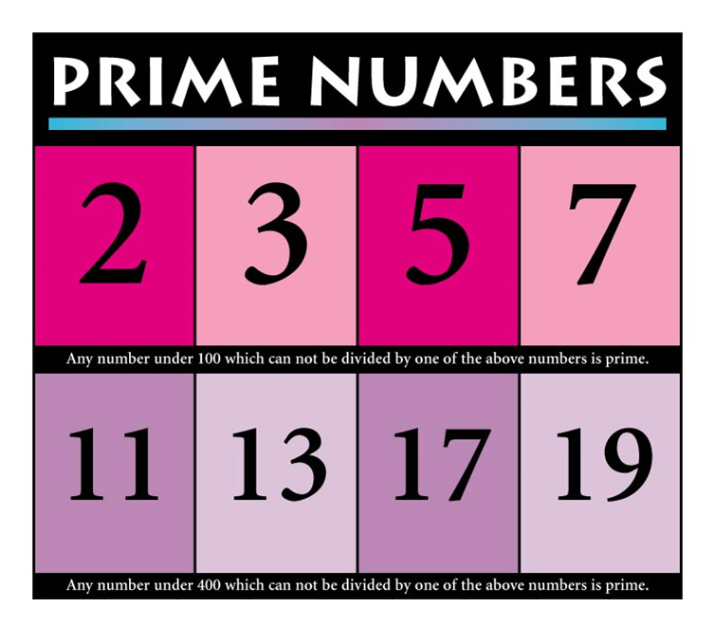
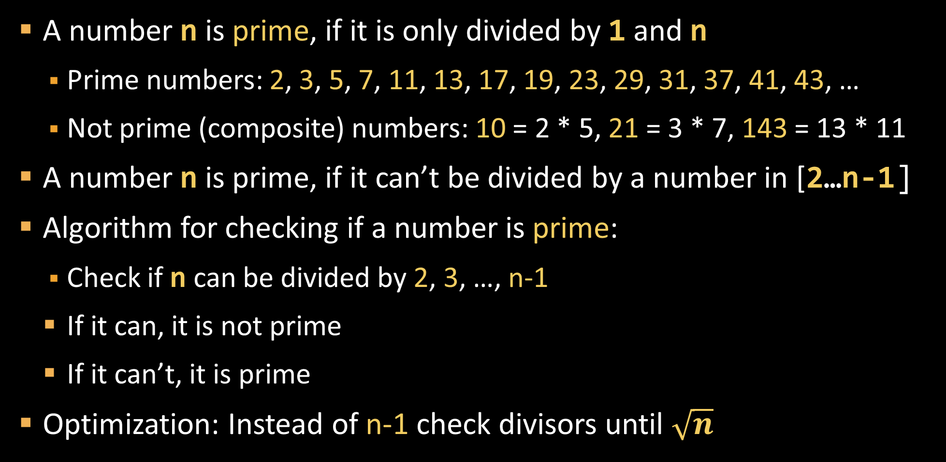
Prime Numbers
A number n is prime, if it is only divided by 1 and n
Prime numbers: 2, 3, 5, 7, 11, 13, 17, 19, 23, 29, 31, 37, 41, 43, …
Not prime (composite) numbers: 10 = 2 * 5, 21 = 3 * 7, 143 = 13 * 11
A number n is prime, if it can’t be divided by a number in [2…n-1]
Algorithm for checking if a number is prime:
Check if n can be divided by 2, 3, …, n-1
If it can, it is not prime
If it can’t, it is prime
Optimization: Instead of n-1 check divisors until $\sqrt{n}$

Slide 20

Is Number Prime. break operator
var n = int.Parse(Console.ReadLine());
var prime = true;
for (var i = 2; i <= Math.Sqrt(n); i++)
if (n % i == 0) {
prime = false;
break;
}
if (prime) Console.WriteLine("Prime");
else Console.WriteLine("Not prime");
break stops the loop
Testing the solution: https://judge.softuni.bg/Contests/Practice/Index/156#9

Slide 21
Operator break in an infinite loop
Write a program, which reads an even number
If the number is invalid, ask for input again
var n = 0;
while (true)
{
Console.Write("Enter even number: ");
n = int.Parse(Console.ReadLine());
if (n % 2 == 0)
break; // even number -> exit from the loop
Console.WriteLine("The number is not even.");
}
Console.WriteLine("Even number entered: {0}", n);

Slide 22


Getting wrong numbers: try … catch
try
{
Console.Write("Enter even number: ");
n = int.Parse(Console.ReadLine());
if (n % 2 == 0)
break;
Console.WriteLine("The number is not even.");
}
catch
{
Console.WriteLine("Invalid number.");
}
If int.Parse(…) fails, the catch { … } block will execute
Testing the solution: https://judge.softuni.bg/Contests/Practice/Index/156#10

Slide 23



Problems with Loops
loops

Slide 24
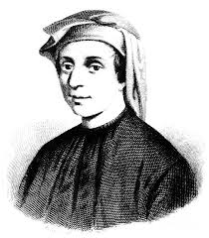
Fibonacci’s numbers
Fibonacci’s numbers are: 1, 1, 2, 3, 5, 8, 13, 21, 34, …
F₀ = 1
F₁ = 1
F_{n} = F_{n-1} + F_{n-2}
var n = int.Parse(Console.ReadLine());
var f0 = 1;
var f1 = 1;
for (var i = 0; i < n-1; i++)
{
var fNext = f0 + f1;
f0 = f1;
f1 = fNext;
}
Console.WriteLine(f1);
Example: F(15) = 987
Input n and calculate the n-th Fibonacci number
Testing the solution: https://judge.softuni.bg/Contests/Practice/Index/156#11

Slide 25

Pyramid of numbers
Print the numbers 1…n in a pyramid as in the examples:
n = 7
n = 10
n = 12
n = 15
1
2 3
4 5 6
7
1
2 3
4 5 6
7 8 9 10
1
2 3
4 5 6
7 8 9 10
11 12
1
2 3
4 5 6
7 8 9 10
11 12 13 14 15
Testing the solution: https://judge.softuni.bg/Contests/Practice/Index/156#12

Slide 26

Pyramid of numbers - solution
var n = int.Parse(Console.ReadLine());
var num = 1;
for (var row = 1; row <= n; row++)
{
for (var col = 1; col <= row; col++)
{
if (col > 1) Console.Write(" ");
Console.Write(num);
num++;
if (num > n) break;
}
Console.WriteLine();
if (num > n) break;
}
1
2 3
4 5 6
7 8 9 10
11 12

Slide 27

Table with numbers
Print the numbers 1…n in a table as in the examples:
n = 2
n = 3
n = 4
n = 5
1 2
2 1
1 2 3
2 3 2
3 2 1
1 2 3 4
2 3 4 3
3 4 3 2
4 3 2 1
1 2 3 4 5
2 3 4 5 4
3 4 5 4 3
4 5 4 3 2
5 4 3 2 1
Testing the solution: https://judge.softuni.bg/Contests/Practice/Index/156#13

Slide 28
Table with numbers – solution
var n = int.Parse(Console.ReadLine());
for (int row = 0; row < n; row++)
{
for (int col = 0; col < n; col++)
{
var num = row + col + 1;
if (num > n) num = 2 * n - num;
Console.Write(num + " ");
}
Console.WriteLine();
}
1 2 3 4 5
2 3 4 5 4
3 4 5 4 3
4 5 4 3 2
5 4 3 2 1
Testing the solution: https://judge.softuni.bg/Contests/Practice/Index/156#13

Slide 29
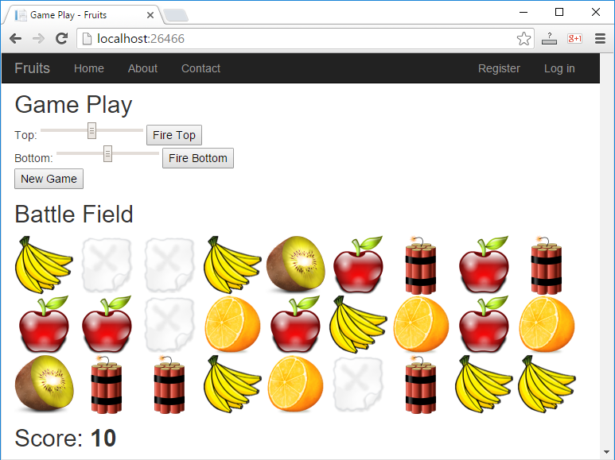
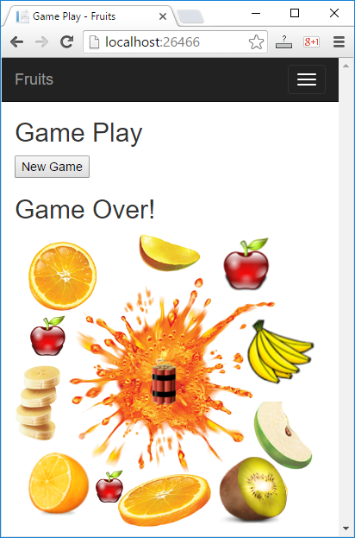
Web game with ASP.NET MVC
Shoot the fruits!

Slide 30
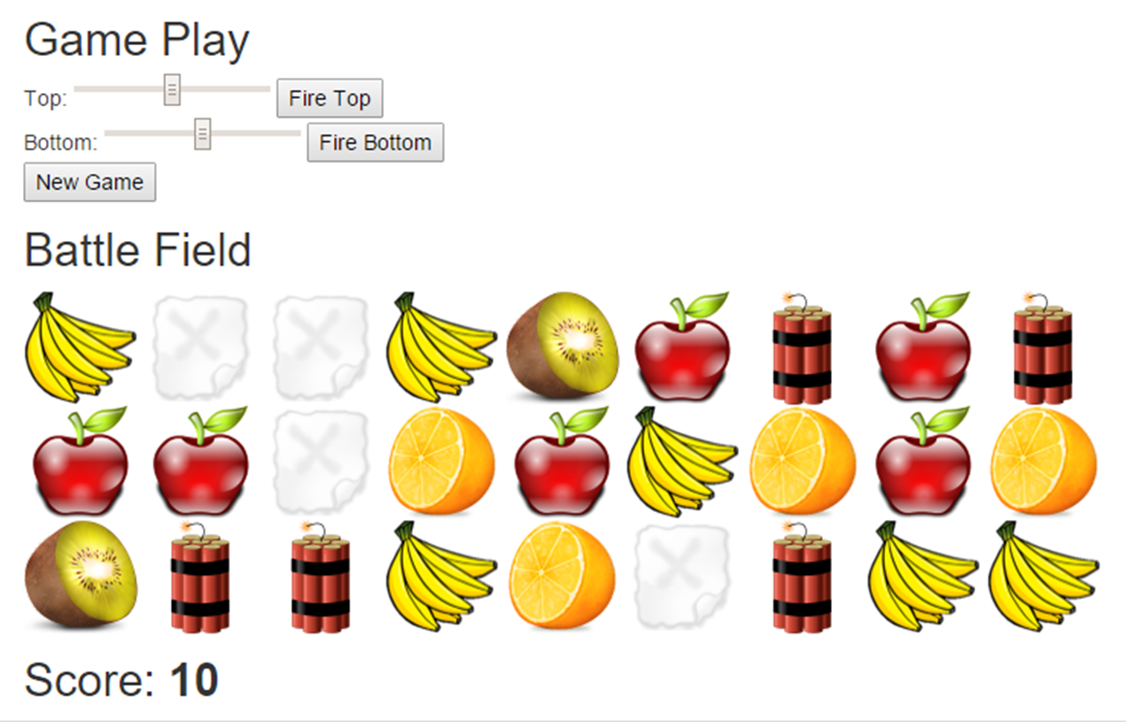
Web game “Shoot the fruits!"

Slide 31
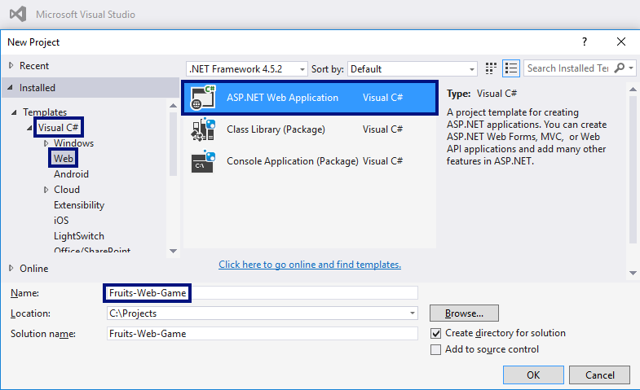
Create a web application in VS

Slide 32
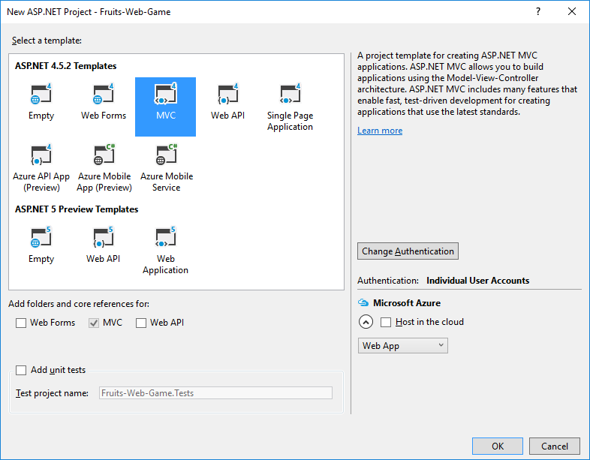
Type of web project → MVC

Slide 33
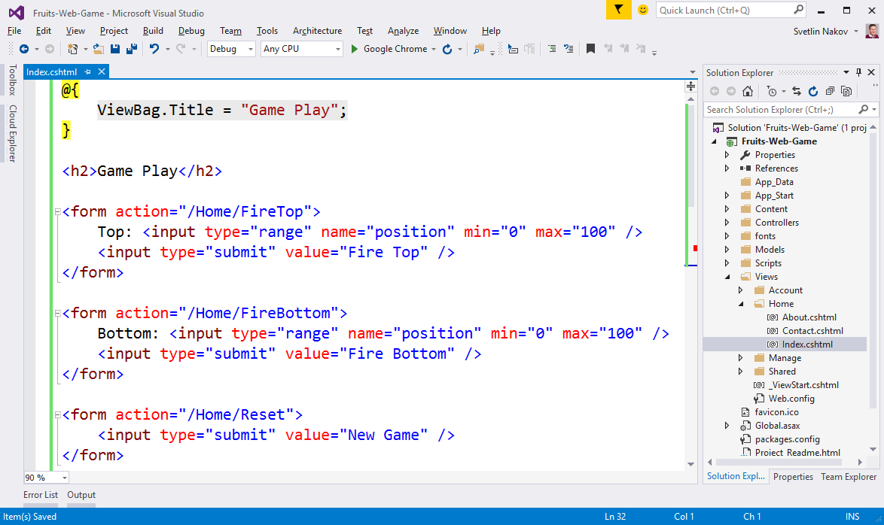
Create the controls in the game

Slide 34
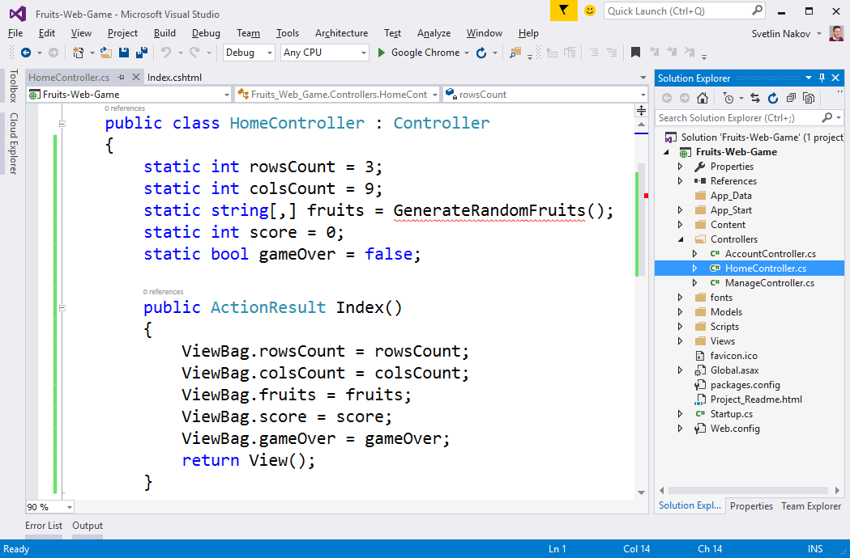
Prepare the fruits in the HomeController

Slide 35
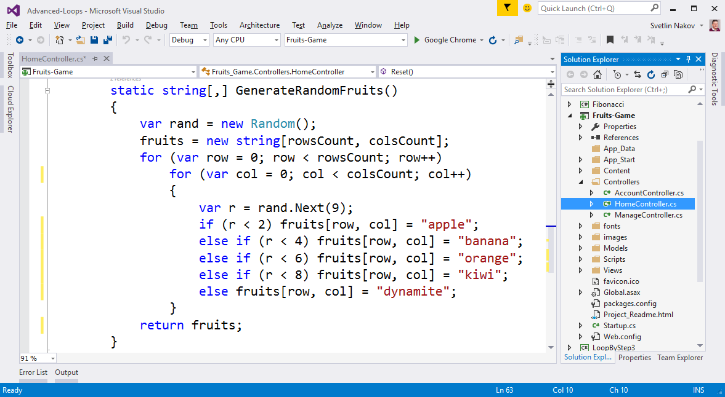
Generate random fruits

Slide 36
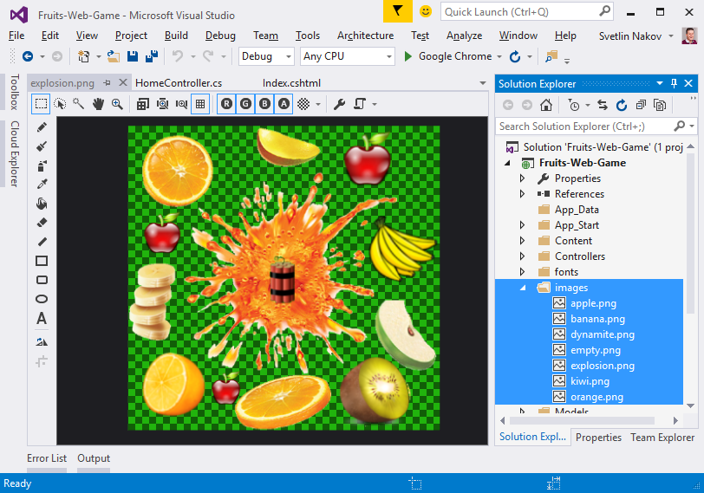
Add the images in the project

Slide 37
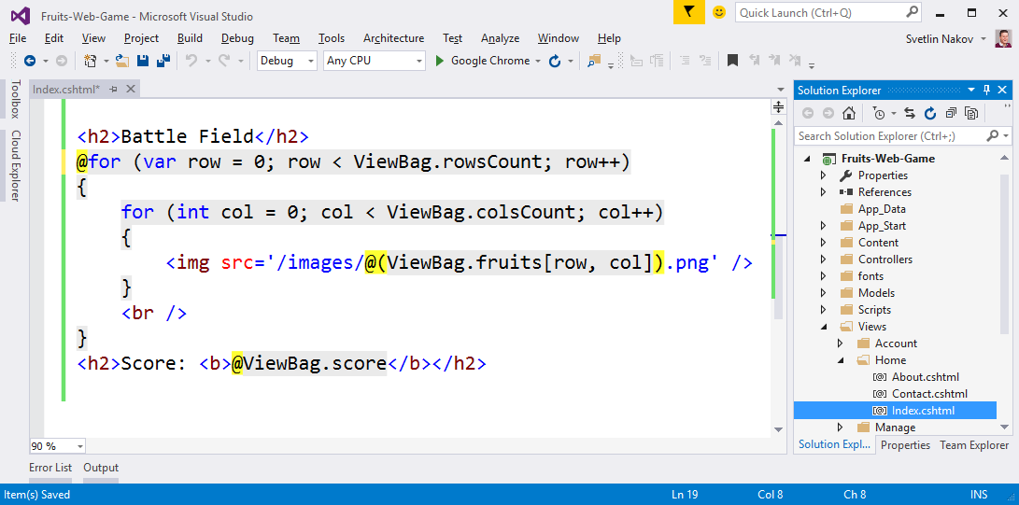
Draw the fruits in Index.cshtml

Slide 38
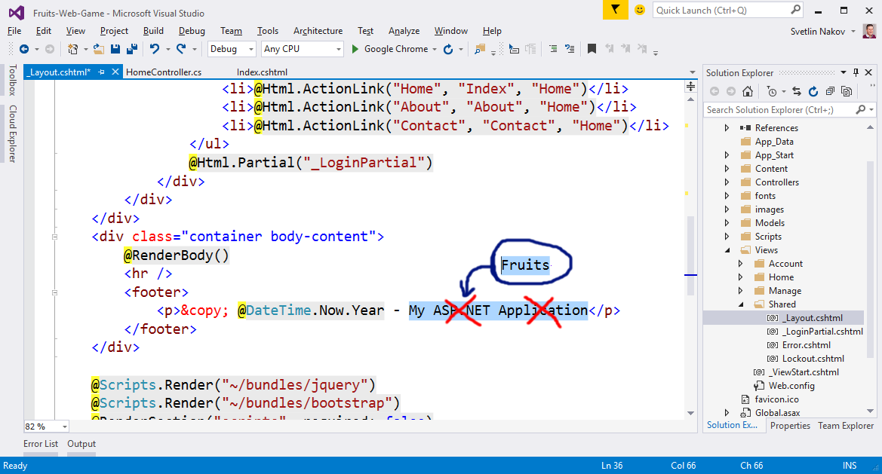
Setup the texts in _Layout.cshtml

Slide 39
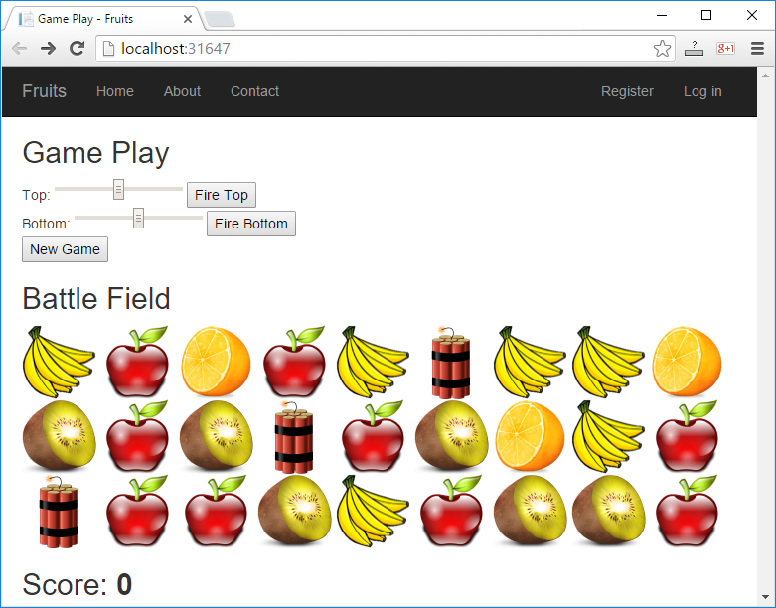
Start with [Ctrl+F5] and test

Slide 40
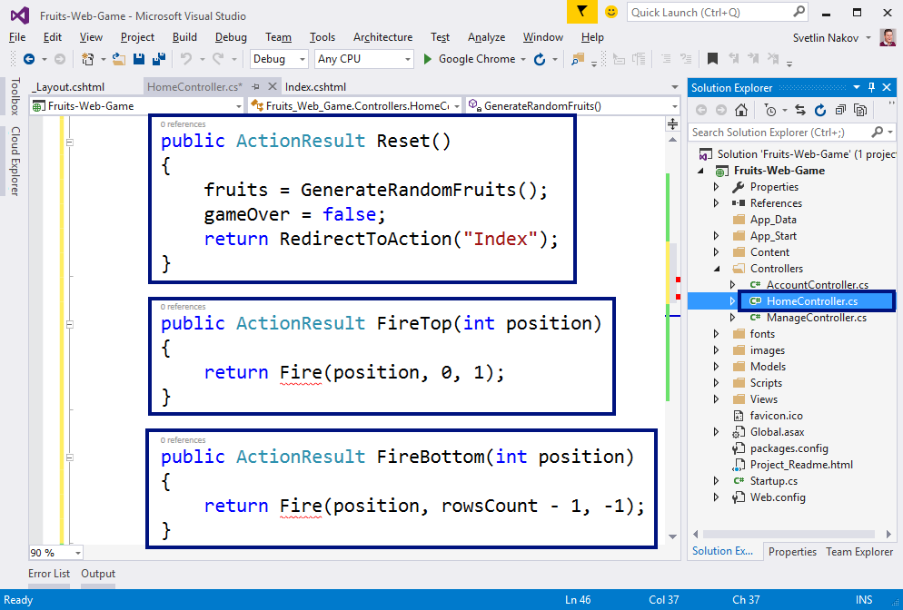
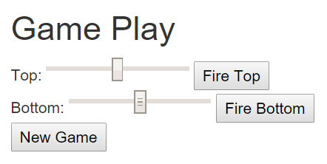
Add actions "Reset" and "Fire"

Slide 41
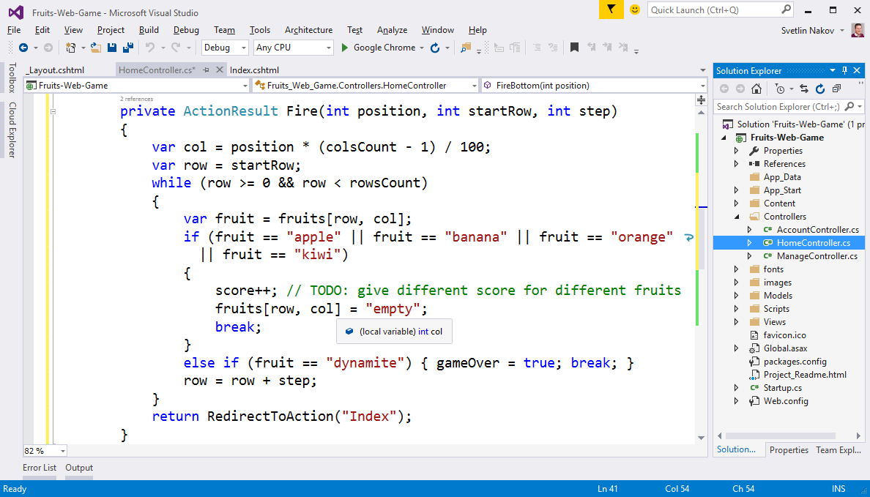
Implement "shooting"

Slide 42
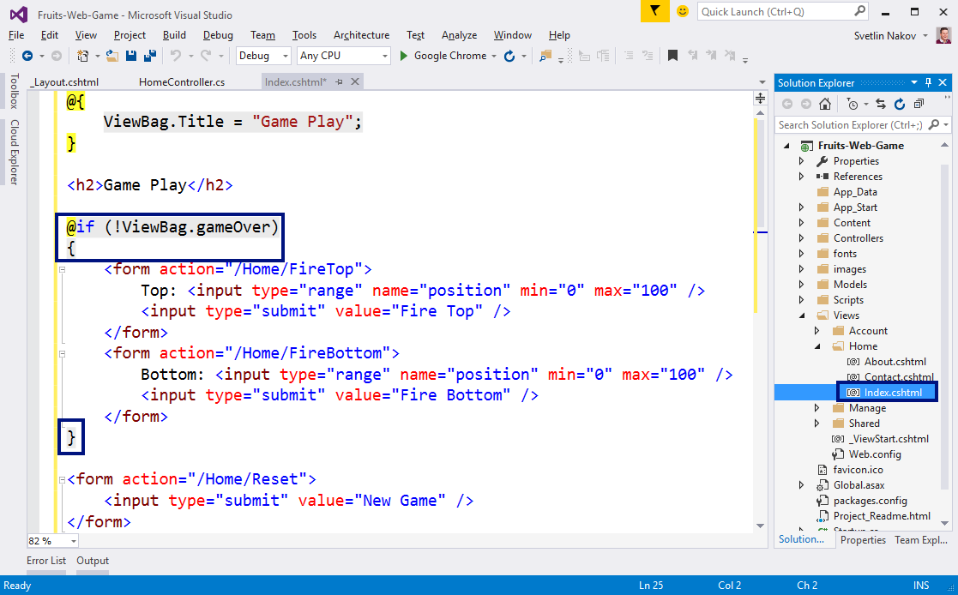
Implement "Game Over"

Slide 43
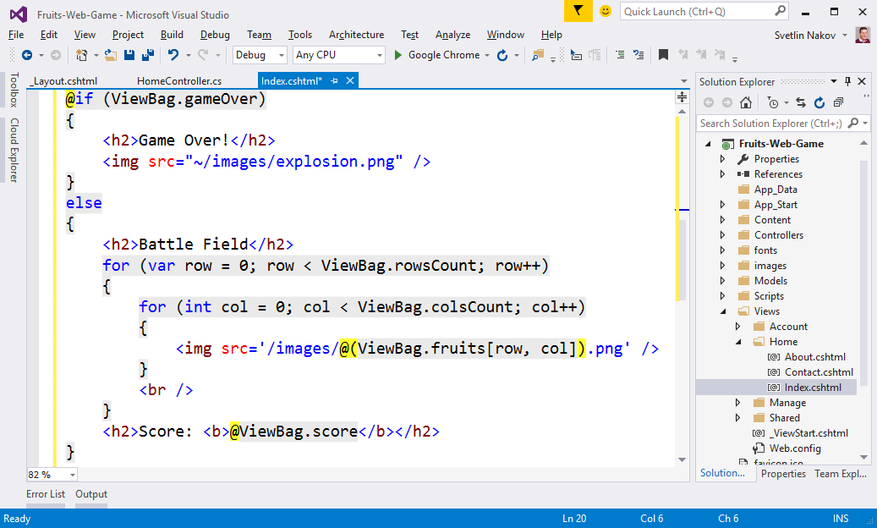
Implement "Game Over" (2)

Slide 44
Start with [Ctrl+F5] and test

Slide 45

What did we learn today?
We can use for-loops with a step:
while / do-while loops iterate while a given condition is met:
for (var i = 1; i <= n; i+=3)
Console.WriteLine(i);
int num = 1;
while (num <= n)
Console.WriteLine(num++);

